Slide 1
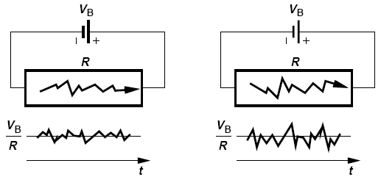
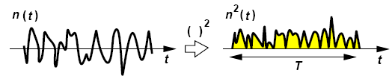
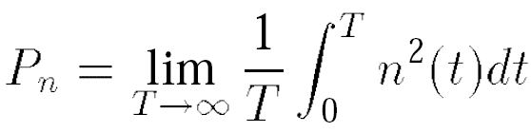
Noise: Noise as a Random Process
Higher temperature
The average current remains equal to V_{B}/R but the instantaneous current displays random values
T must be long enough to accommodate several cycles of the lowest frequency.

Slide 2
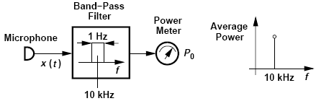
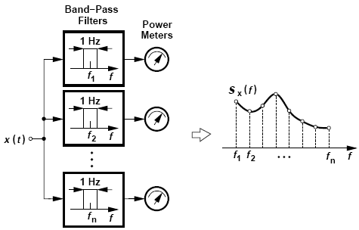
Measurement of Noise Spectrum
To measure signal’s frequency content at 10 kHz, we need to filter out the remainder of the spectrum and measure the average power of the 10-kHz component.

Slide 3
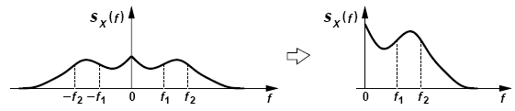
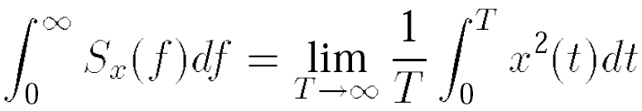
Noise Spectrum: Power Spectral Density (PSD)
Two-Sided
One-Sided
Total area under S_{x}(f) represents the average power carried by x(t)

Slide 4

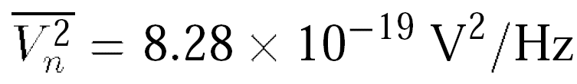
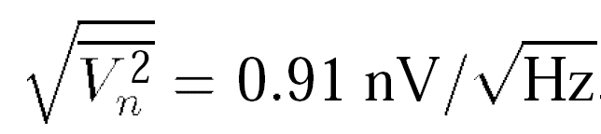
Example of Noise Spectrum
A resistor of value R₁ generates a noise voltage whose one-sided PSD is given by
where k = 1.38 × 10-23 J/K denotes the Boltzmann constant and T the absolute temperature. Such a flat PSD is called “white” because, like white light, it contains all frequencies with equal power levels.
(a) What is the total average power carried by the noise voltage?
(b) What is the dimension of S_{v}(f)?
(c) Calculate the noise voltage for a 50-Ω resistor in 1 Hz at room temperature.
(a) The area under S_{v}(f) appears to be infinite, an implausible result because the resistor noise arises from the finite ambient heat. In reality, S_{v}(f) begins to fall at f > 1 THz, exhibiting a finite total energy, i.e., thermal noise is not quite white.
(b) The dimension of S_{v}(f) is voltage squared per unit bandwidth (V2/Hz)
(c) For a 50-Ω resistor at T = 300 K

Slide 5

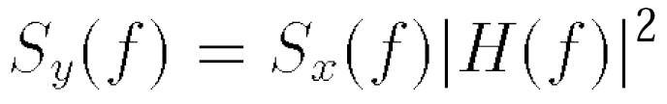
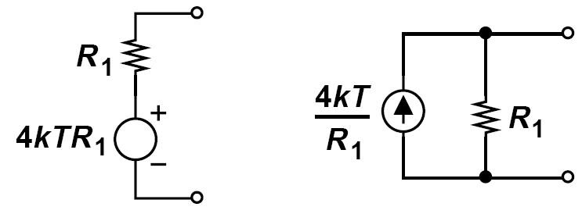
Effect of Transfer Function on Noise/ Device Noise
Define PSD to allow many of the frequency-domain operations used with deterministic signals to be applied to random signals as well.
Noise can be modeled by a series voltage source or a parallel current source
Polarity of the sources is unimportant but must be kept same throughout the calculations

Slide 6
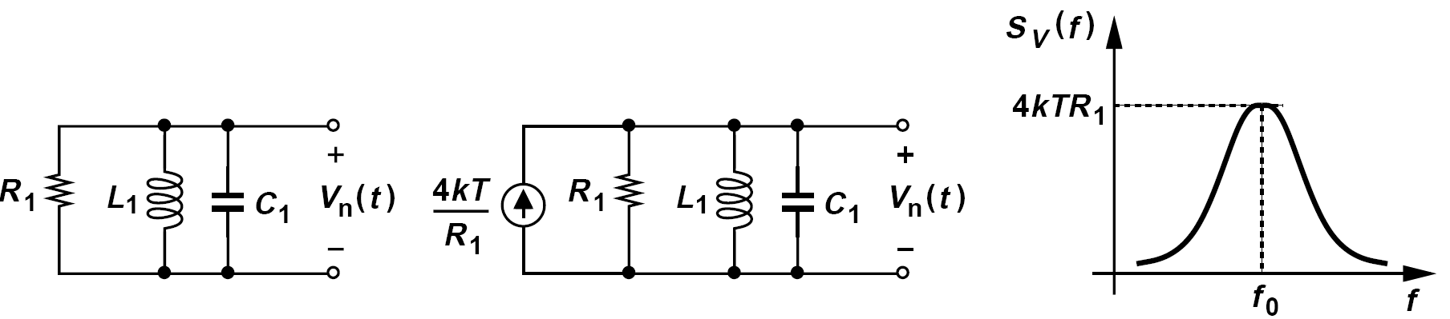
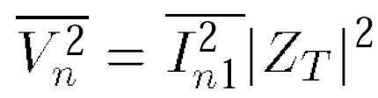
Example of Device Noise
Sketch the PSD of the noise voltage measured across the parallel RLC tank depicted in figure below.
Modeling the noise of R₁ by a current source and noting that the transfer function V_{n}/I_{n1} is, in fact, equal to the impedance of the tank, Z_{T} , we write
At f₀, L₁ and C₁ resonate, reducing the circuit to only R₁. Thus, the output noise at f₀
is simply equal to 4kTR₁. At lower or higher frequencies, the impedance of the tank falls and so does the output noise.

Slide 7
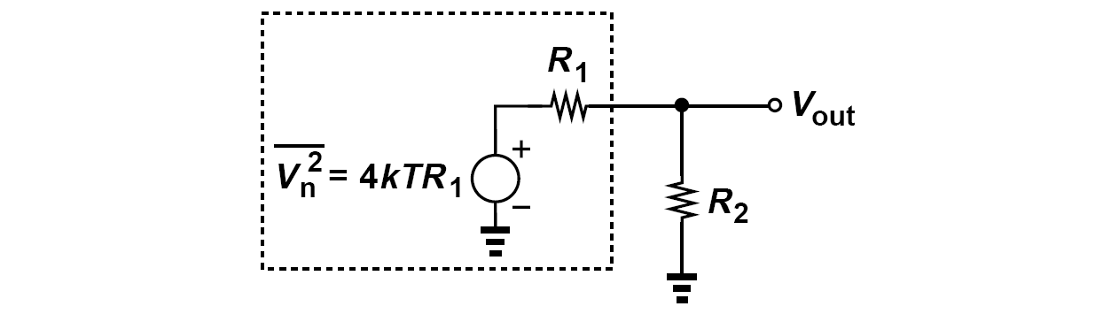
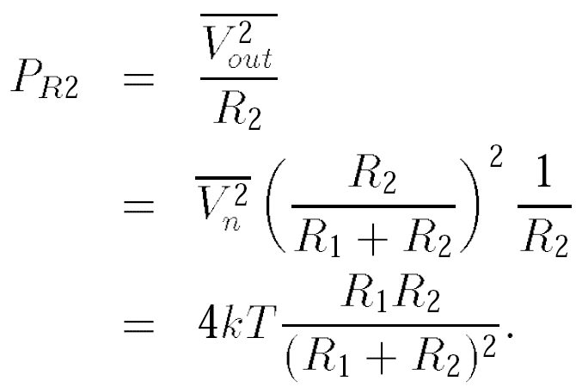
Can We Extract Energy from Resistor?
Suppose R₂ is held at T = 0 K
This quantity reaches a maximum if R₂ = R₁ :
P_{R2,max} = kT
Available noise power

Slide 8
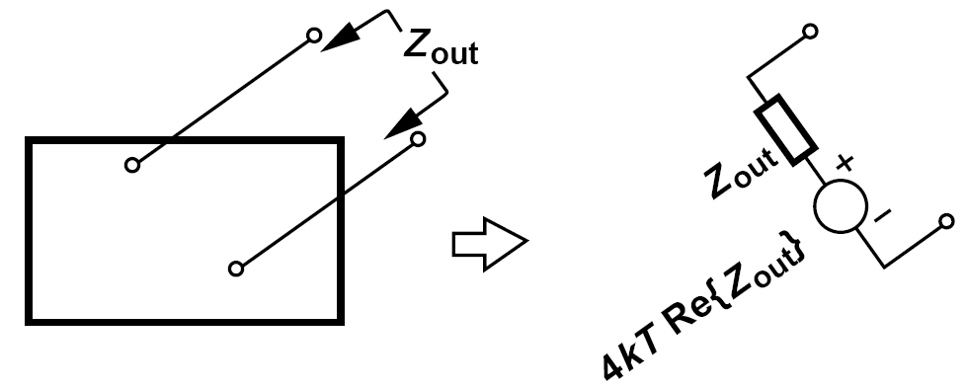
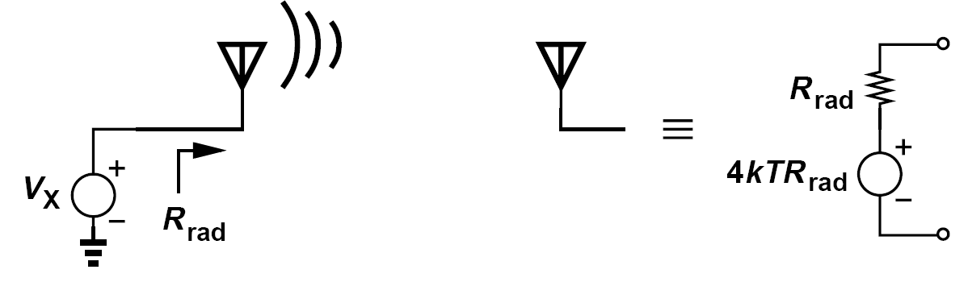

A Theorem about Lossy Circuit
If the real part of the impedance seen between two terminals of a passive (reciprocal) network is equal to Re{Z_{out}}, then the PSD of the thermal noise seen between these terminals is given by 4kTRe{Z_{out}}
An example of transmitting antenna, with radiation resistance R_{rad}

Slide 9
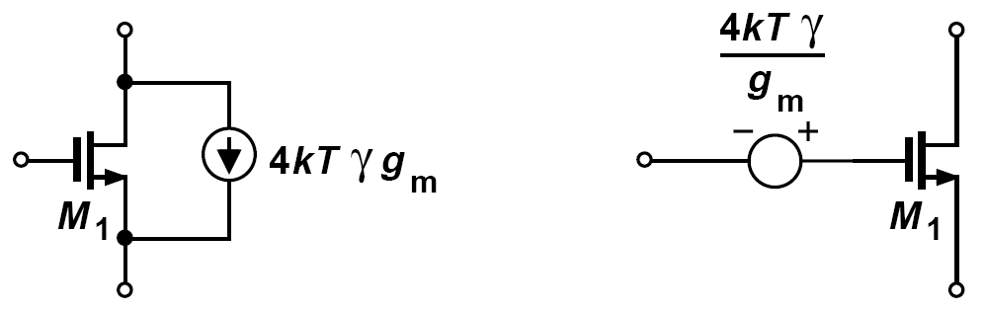


Noise in MOSFETS
Thermal noise of MOS transistors operating in the saturation region is approximated by a current source tied between the source and drain terminals, or can be modeled by a voltage source in series with gate.

Slide 10
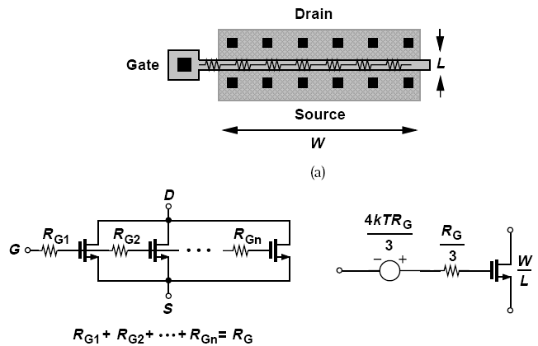
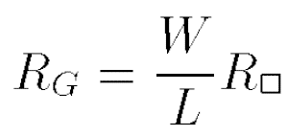
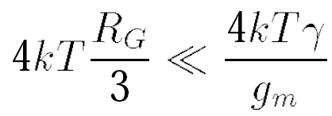
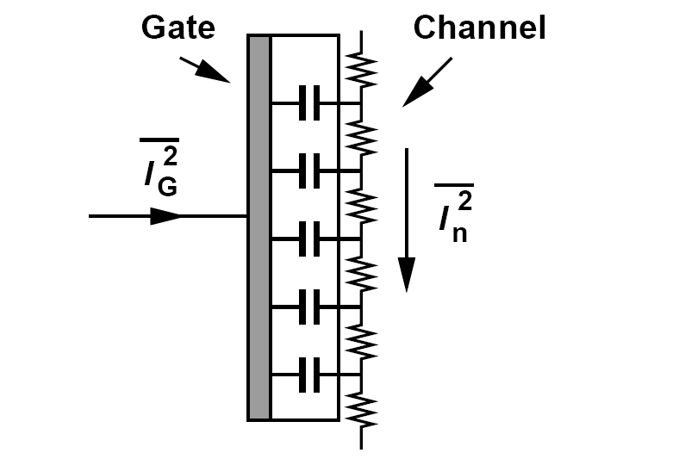
Gate-induced Noise Current
At very high frequencies, thermal noise current flowing through the channel couples to the gate capacitively

Slide 11
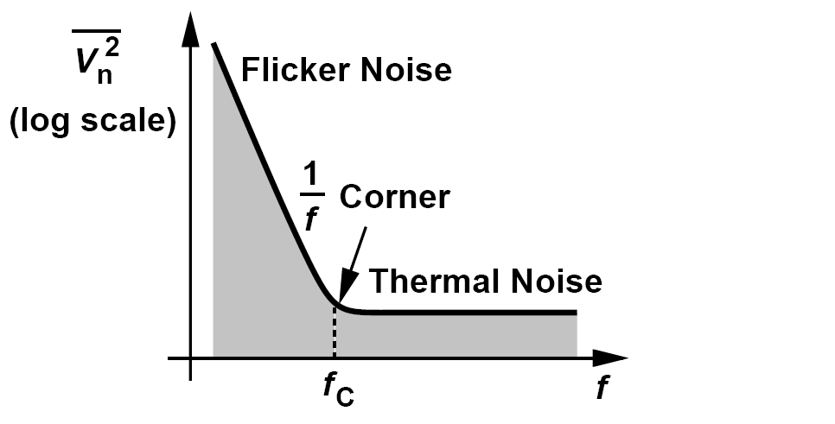
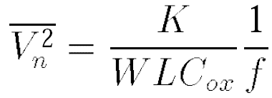
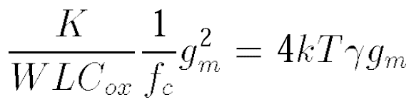
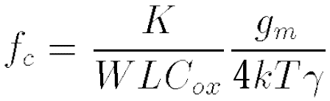
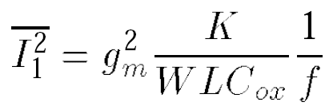
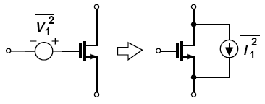
Flicker Noise and An Example
Can the flicker noise be modeled by a current source?
Yes, a MOSFET having a small-signal voltage source of magnitude V₁ in series with its gate is equivalent to a device with a current source of value g_{m}V₁ tied between drain and source. Thus,

Slide 12
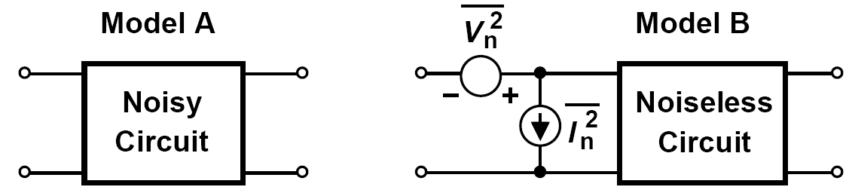
Representation of Noise in Circuits: Input-Referred Noise
Voltage source: short the input port of models A and B and equate their output noise voltage
Current source: leave the input ports open and equate the output noise voltage

Slide 13
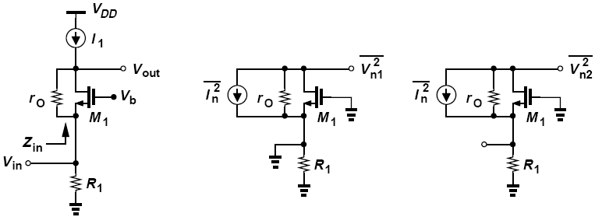


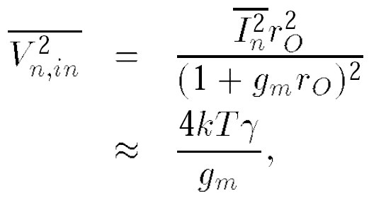
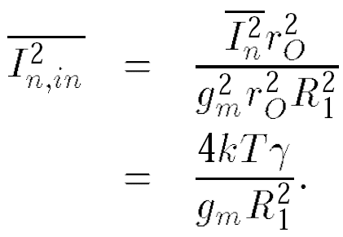
Example of Input-Referred Noise
Calculate the input-referred noise of the common-gate stage depicted in figure below (left). Assume I₁ is ideal and neglect the noise of R₁.
Solution:
noise voltage
noise current

Slide 14
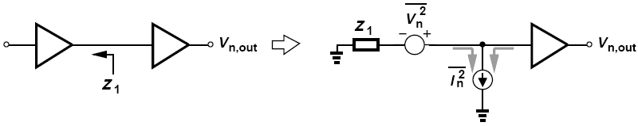
Another Example of Input-Referred Noise
Explain why the output noise of a circuit depends on the output impedance of the preceding stage.
Solution:
Modeling the noise of the circuit by input-referred sources, we observe that some of noise current flows through Z₁, generating a noise voltage at the input that depends on |Z₁|. Thus, the output noise, V_{n,out}, also depends on |Z₁|.

Slide 15
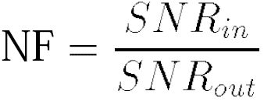
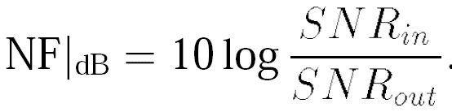
Noise Figure
Depends on not only the noise of the circuit under consideration but the SNR provided by the preceding stage
If the input signal contains no noise, NF=∞

Slide 16
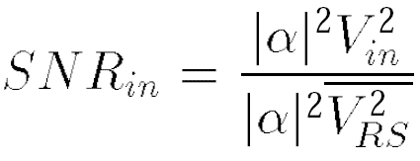
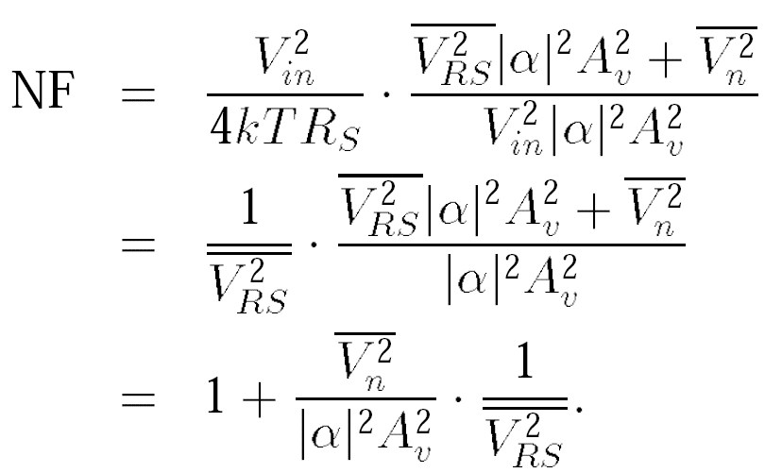
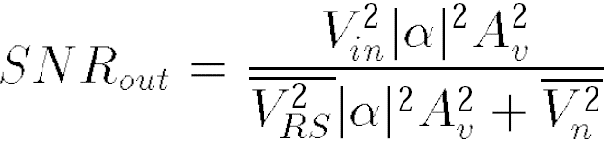
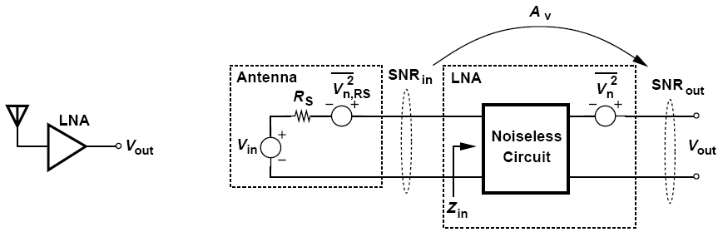

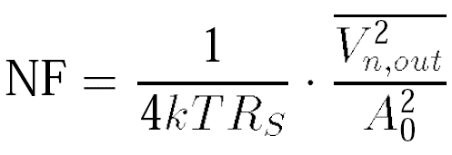
Calculation of Noise Figure
NF must be specified with respect to a source impedance-typically 50 Ω
Reduce the right hand side to a simpler form:

Slide 17
Calculation of NF: Summary
Calculation of NF
Divide total output noise by the gain from V_{in} to V_{out} and normalize the result to the noise of R_{s}
Calculate the output noise due to the amplifier, divide it by the gain, normalize it to 4kTR_{s} and add 1 to the result
Valid even if no actual power is transferred. So long as the derivations incorporate noise and signal voltages, no inconsistency arises in the presence of impedance mismatches or even infinite input impedances.

Slide 18
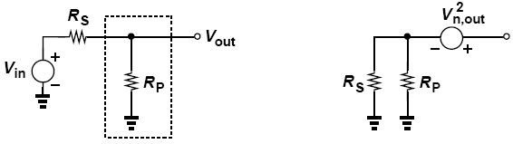

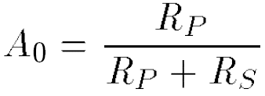
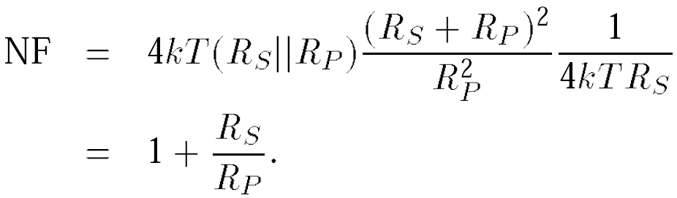
Example of Noise Figure Calculation
Compute the noise figure of a shunt resistor R_{P} with respect to a source impedance R_{S}
Solution:
Setting V_{in} to zero:

Slide 19
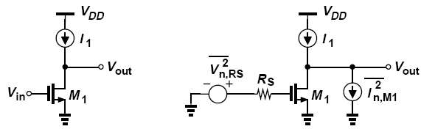
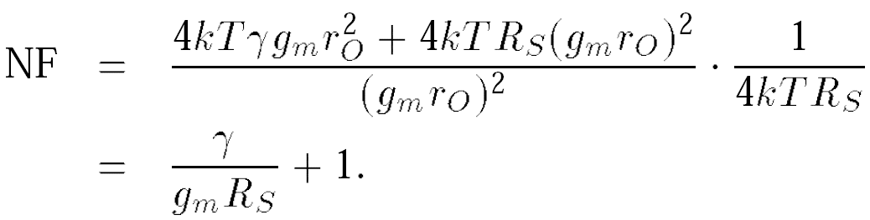
Another Example of Noise Figure Calculation
Determine the noise figure of the common-source stage shown in below (left) with respect to a source impedance R_{S}. Neglect the capacitances and flicker noise of M₁ and assume I₁ is ideal.
Solution:
This result implies that the NF falls as R_{S} rises. Does this mean that, even though the amplifier remains unchanged, the overall system noise performance improves as R_{S} increases?!

Slide 20
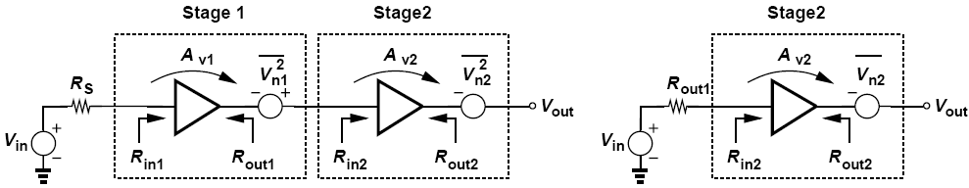
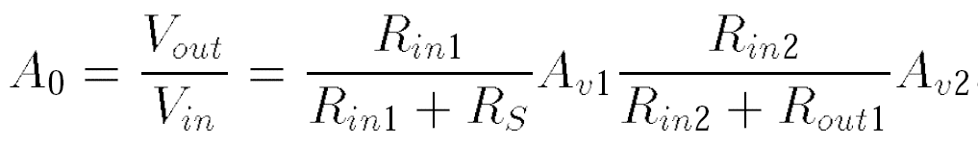
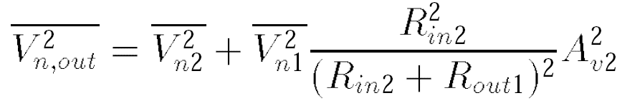
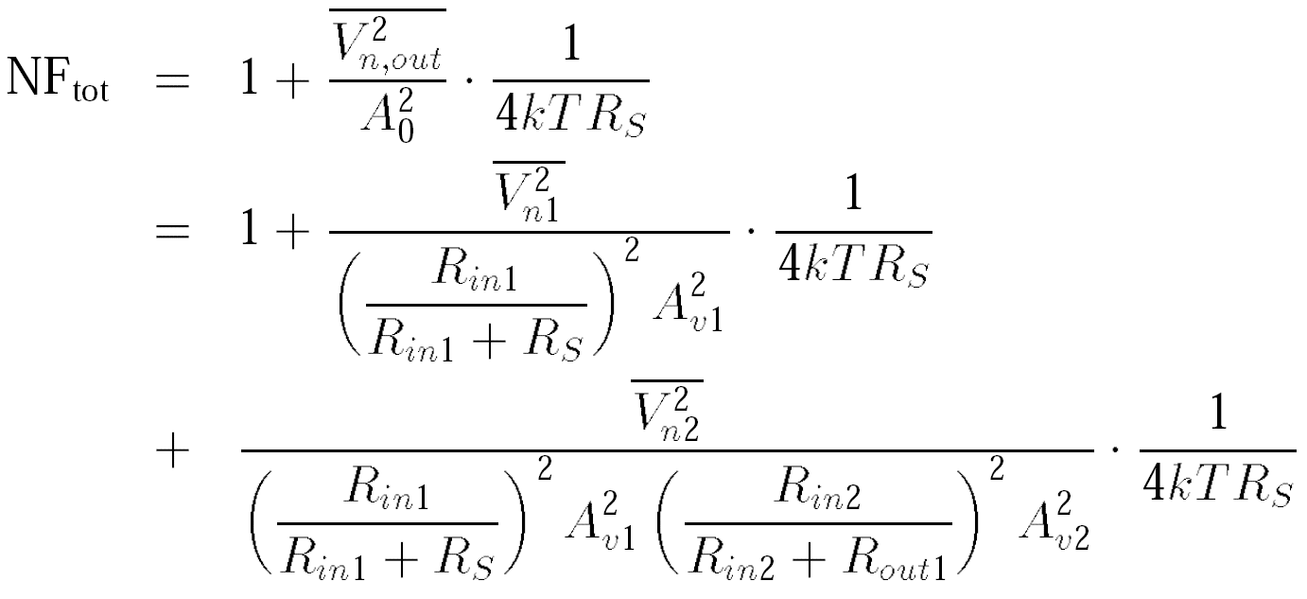
Noise Figure of Cascaded Stages (Ⅰ)

Slide 21
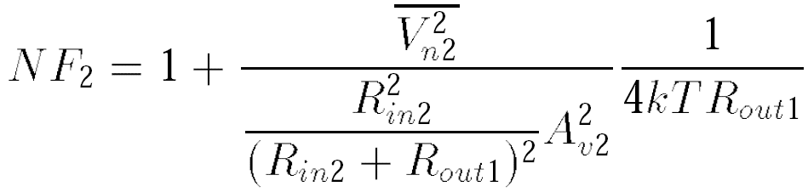




Noise Figure of Cascaded Stages (Ⅱ)
This quantity is in fact the “available power gain” of the first stage, defined as the “available power” at its output, P_{out,av} (the power that it would deliver to a matched load) divided by the available source power, P_{S,av} (the power that the source would deliver to a matched load).
Called “Friis’ equation”, this result suggests that the noise contributed by each stage decreases as the total gain preceding that stage increases, implying that the first few stages in a cascade are the most critical.

Slide 22




Example of Noise Figure of Cascaded Stages
Determine the NF of the cascade of common-source stages shown in figure below. Neglect the transistor capacitances and flicker noise.
Solution:
where

Slide 23





Another Example of Noise Figure of Cascaded Stages
Determine the noise figure of the circuit shown below. Neglect transistor capacitances, flicker noise, channel-length modulation , and body effect.
Solution:

Slide 24






Noise Figure of Lossy Circuits
The power loss is calculated as:

Slide 25



Example of Noise Figure of Lossy Circuits
The receiver shown below incorporates a front-end band-pass filter (BPF) to suppress some of the interferers that may desensitize the LNA. If the filter has a loss of L and the LNA a noise figure of NF_{LNA}, calculate the overall noise figure.
Solution:
Denoting the noise figure of the filter by NF_{filt},
we write Friis’ equation as
where NF_{LNA} is calculated with respect to the output resistance of the filter. For example, if L = 1.5 dB and NF_{LNA} = 2 dB, then NF_{tot} = 3.5 dB.

Slide 26


Sensitivity and Dynamic Range: Sensitivity
The sensitivity is defined as the minimum signal level that a receiver can detect with “acceptable quality.”
Noise Floor

Slide 27
Example of Sensitivity
A GSM receiver requires a minimum SNR of 12 dB and has a channel bandwidth of 200 kHz. A wireless LAN receiver, on the other hand, specifies a minimum SNR of 23 dB and has a channel bandwidth of 20 MHz. Compare the sensitivities of these two systems if both have an NF of 7 dB.
Solution:
For the GSM receiver, P_{sen} = -102 dBm, whereas for the wireless LAN system, P_{sen} = -71 dBm. Does this mean that the latter is inferior? No, the latter employs a much wider bandwidth and a more efficient modulation to accommodate a data rate of 54 Mb/s. The GSM system handles a data rate of only 270 kb/s. In other words, specifying the sensitivity of a receiver without the data rate is not meaningful.

